Slide 1


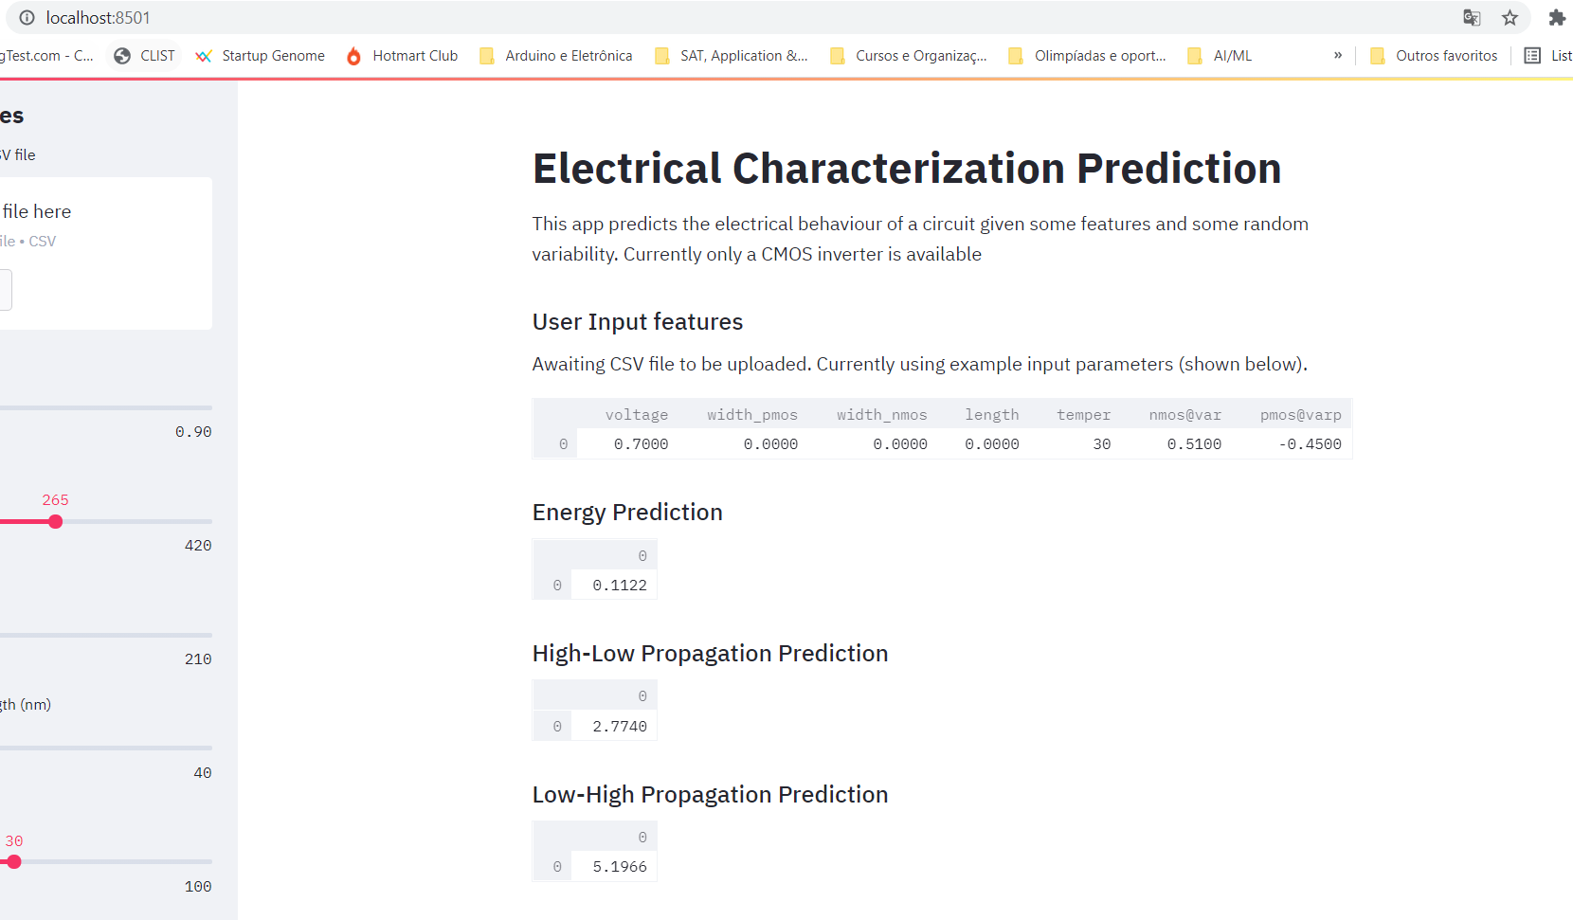
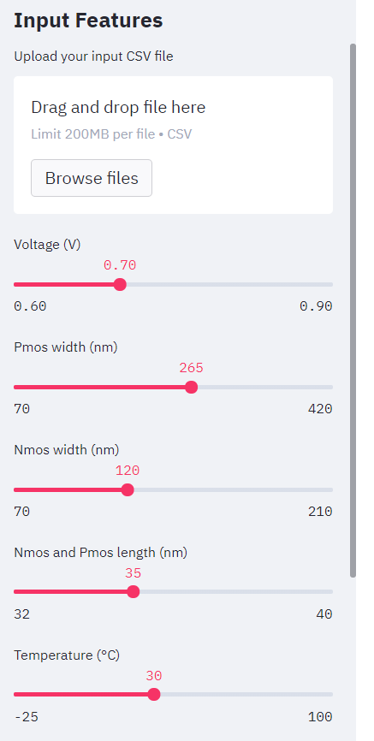
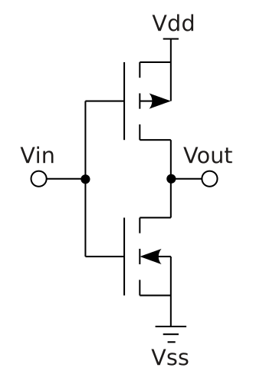
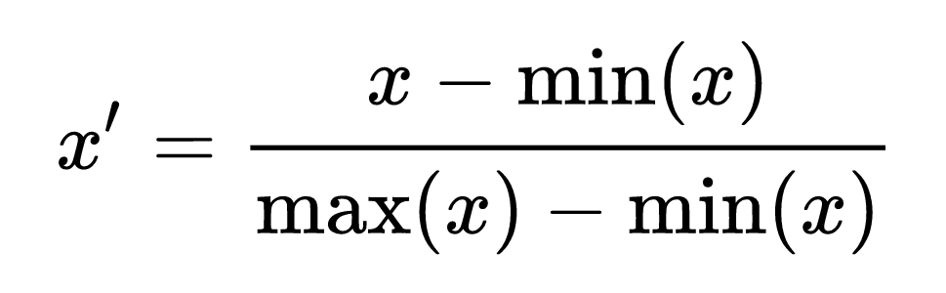

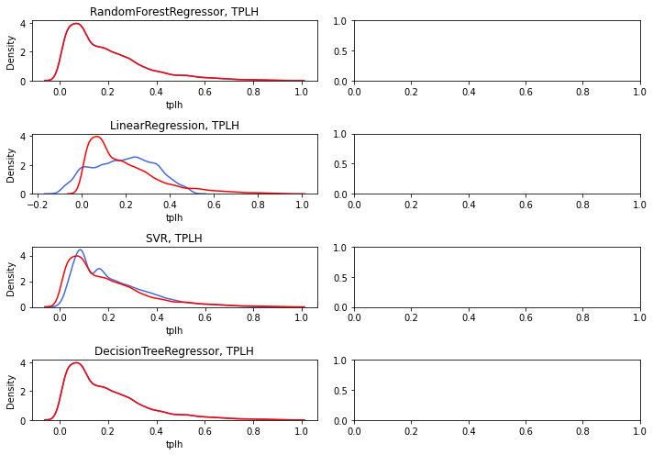
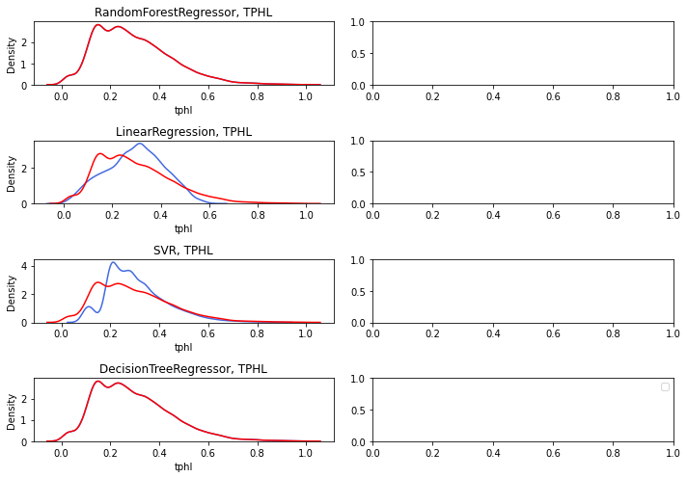
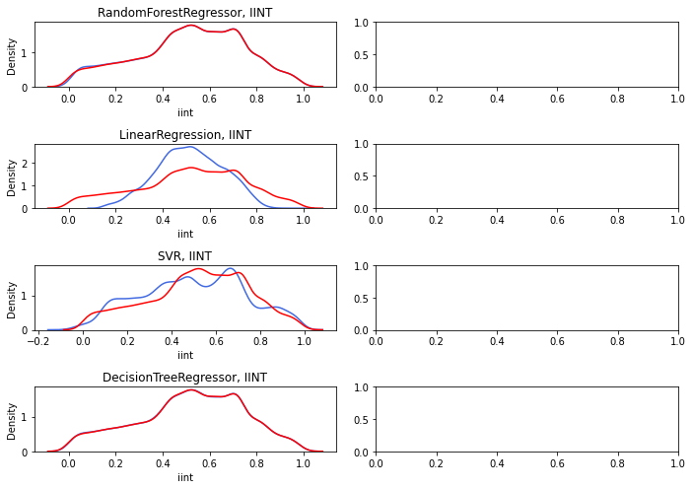








11th IEEE CASS Rio Grande do Sul Workshop 2021
Electrical Behavior Prediction Of An Inverter Using Machine Learning Algorithms
Variations in Nanometer CMOS Flip-Flops: Part I—Impact of Process Variations on Timing
Gabriel Lima Jacinto, Mateus Grellert, Cristina Meinhardt
Introduction & Goal
More corner cases must be considered during the electrical characterization [1]
Machine learning can assist digital design in many levels
Goal: to evaluate regression algorithms for electrical characterization
First case study: CMOS inverter (32nm)
VII. Model Deployment
I. Simulation
II. Targets
III. Data Processing
IV. Algorithms
Energy
TPHL
TPLH
50%
Training Set
Multiple Linear Regression
Support Vector Machine
Decision Trees
Random Forest
Min-Max Scaler
II. Features
25%
Validation Set
Voltage
Temperature
Width PMOS
Width NMOS
Length
Nmos Vth0
Pmos Vth0
V. Evaluation
25%
Test Set
Conclusion
Source: Wikipedia
VI. Results
Best algorithm:
Random Forest
Worst algorithm:
Linear Regression
Model was deployed as web application with Streamlit.
Future steps include to explore other gates and technologies as FINFET.
Random Forest, TPLH
Random Forest, TPHL
Random Forest, IINT
Methodology
(I) 1000 Monte Carlo simulations in HSPICE
(II) Dataset: HSPICE + circuit data
(III) Scaled the values to the range [0,1] and split the data (train, test, validation)
(IV) trained the algorithms using cross validation.
(V) RMSE was used as the cost function.
Linear Regressor, TPLH
Linear Regressor, TPHL
Linear Regressor, IINT
Correct Output
Predicted Output
References
Affiliation:
[1] Massimo Alioto, et al.,Variations in Nanometer CMOS Flip-Flops: Part I—Impact of Process Variations on Timing, IEEE TCAS I, 2015.
Sponsors:
Universidade Federal de Santa Catarina
Sistemas de Informação
Florianópolis/Santa Catarina, Brasil Contact: gabriellimajacinto@gmail.com
11th IEEE CASS Rio Grande do Sul Workshop – September 29 - October 1, 2021 – Porto Alegre, Brazil
Notes:
A4 page (21 x 29.7 cm) PDF
Stick to the template in the following areas: main title, author list, affiliation and contact sections
The remaining can be freely modified to suit your needs
Go straight to the point, simple, clear, preferring images to text with credit to the sources
Your 5-min video will provide further explanations

Slide 2
As technologies advance, more challenges are emerging. The variability and design rules become more extensive and more complex. Consequently, design tools have to solve increasingly complex problems, and these difficulties directly reflect on the cost of developing electronic device designs. One of the major challenges of nanoscale technologies is process variability, which affects the expected normal behavior of the cells, changing the delay and power consumption observed at nominal conditions. This expands the cell characterization to enclose now multiple corners, instead of the traditional fast, low and nominal corners, which can be a very time-consuming task. In recent studies, Machine Learning has been employed in several EDA applications to model non-linear relationships and to solve difficult problems. Therefore, this work evaluates machine learning regression algorithms as an alternative to the electrical simulation of logic cells. Four regression methods were investigated, namely Multiple Linear Regression (MLR), Support Vector Regression (SVR), Decision Tree (DT), and Random Forest (RF). As a case study, the models were trained to predict the propagation time and the energy consumption of the CMOS inverter circuit, using voltage, temperature, cell dimensions, and process variability as input variables. A comparative analysis is made for each variable between all four models in order to understand which one is the best regression model suited for the task. The best algorithm proved to be the Random Forest for all the predicted variables, with an RMSE of 10,3x10^-3 for predicting energy, of 3,2x10^-3 for predicting high-low propagation delay, and of 2,8x10^-3 for predicting low-high propagation delay. The prediction methodology presented in this paper will be extended to consider other circuits and technologies in the following steps of this project.

